Slide 1
Homophily

Slide 2
Ego Network Composition
Composition
  Proportions, IQV, Mean, St. Dev.
  Nodal traits or Tie Trats
Composition and Similarity
  Redo composition measures as
    Categorical variable: proportion similar vs. different (on vs. off-diagonal)
    Continuous variable: Average of difference scores
Nodal Trait Clustering
  See in ego network with bias in network composition
    Bias towards people like ego → homophily
    Bias toward people not like ego → heterophily
    No bias
  Seen in whole network as high correlation between yi and yj for xij = 1 (assortativity)
How do you know if there is bias (nodal trait clustering)?

Slide 3
Nodal Trait Clustering
Homophily - nodal trait clustering at level of dyads
  Nodes that are connected by an edge are likely to be more similar than non-connected nodes
Segmentation (segregation) - nodal trait clustering at the whole network level
  Few ties between clusters (segments), most ties within clusters
Macro traits associated with social inequalities (race, gender, class, occupation, religion, education, age, income) → micro patterns of social interaction (ties within and between categorical groups)
  Can also look at variation in behaviors (e.g., health) and tastes (e.g., musical genres)
  And network derived nodal traits (degree, clustering)

Slide 4
Theories (causes) of Homophily
Personal preferences influencing choice of alters (choice homophily - Lazerfeld & Merton)
  People likely to associate with people who are similar to them
Composition of population from which alters are drawn (induced homophily - Blau)
Composition of social foci in which ego interacts with others (Feld)
Size (degree) of ego’s network (Marsden)

Slide 5
Preference
Birds of a feather flock together -- but why?
  Comfort
  Proximity because of physical segregation
  Prejudice and discrimination (animous, unconscious, statistical)
  Identities and salience -- seek out those who are similar
Usually assumes preferences operate at the time of tie formation
  Could also operate during tie evolution (maintenance) and tie decay (dissolution)
Assumes similarities and differences are visible (can be easily known)
Issue of multiform heterogeneity (Blau)
  Because dimensions of stratification are correlated (e.g, religion and race), homophily on a nodal trait could indicate (1) preference for people with that trait or (2) preference for people with another trait that is highly coupled with that trait
Preference for those who are different -- heterophily ?????
Notes:
visibility

Slide 6
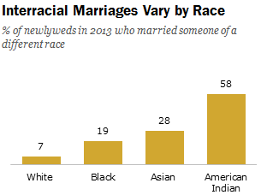
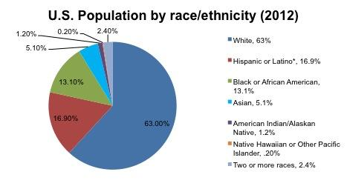
Induced Homophily
Baseline model
  random selection, no preferences
Group Size effects
  Members of numerically smaller social groups are more likely to have ties to members outgroup members
  Members of numerically larger social groups are less likely to have ties to outgroup members
Random selection in context of skewed distributions →
  homophily for majority group members
  Heterophily for minority group members
Biased????

Slide 7
Social Foci
Key insight: People do not form ties at random, but rather they form ties through settings where they meet and interact with others
Social foci
  “ a social, psychological, legal, or physical entity around which joint activities are organized (e.g., workplaces, voluntary organizations, hangouts, families, etc.” (Feld 1981: 1016)
Tie formation via affiliations (e.g., clubs, religious organizations, classes)
Foci vary in constraint (time and energy required) and size
People can belong to multiple intersecting foci
  Can be cross-cutting or overlapping
Composition of foci → composition of ego networks
  Segregated foci → homophily
  Integrated foci → reduce homophily

Slide 8

Ego Network Size (Degree)
Larger networks should be more diverse (heterogeneous)
  Majority Group Members: more likely to choose at random a minority group member if more choices
  Minority Group Members: even if prefer similar others, run out of others as network size increases

Slide 9
Summary
Homophily can be observed at both the ego and dyad level
  Ego network: composition
  Dyad: Similarity between vertices connected by an edge
Dyad Processes -- tie formation
  Preference/Choice
  Induced: random formation within skewed population distributions
  Social Foci: formation through affiliations with skewed population distributions
  Network Size: The more choices a person makes (ie. the larger their network) the more the composition of their network will represent the population distribution.
No triadic processes
  Triadic closure → increases homophily. WHY?
Formation or decay?

